Slide 1
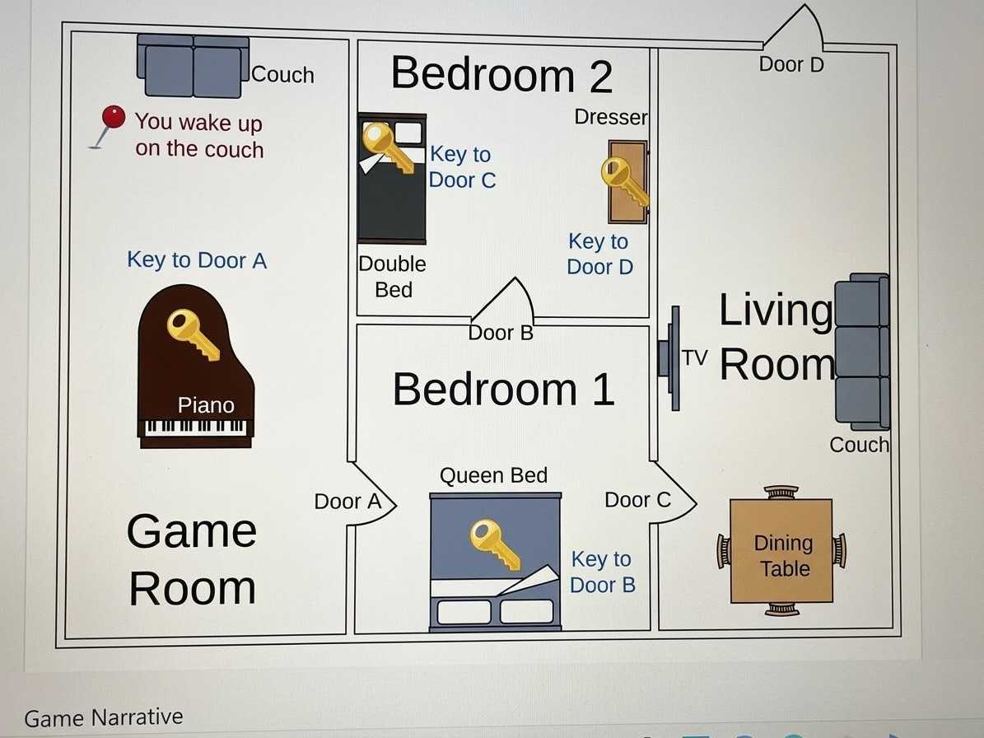
The big escape game
Rooms, Items & Game State — Data Model Walkthrough

Slide 2
DATA MODEL
Items
Furniture
Doors
Keys
Electronics
couch
piano
queenbed
doublebed
dresser
diningtable
living_couch
door_a
door_b
door_c
door_d
key_a → door_a
key_b → door_b
key_c → door_c
key_d → door_d
TV

Slide 3
DATA MODEL
Rooms
Game Room
couch, piano, door_a
Bedroom 1
queenbed, door_a, door_b, door_c
Bedroom 2
doublebed, door_b, dresser
Living Room
diningtable, door_c, door_d, living_couch, TV
Outside
door_d (target room)

Slide 4
DATA MODEL
Doors Connect Rooms
Door A
Door B
Door C
Door D
Game Room ⇄ Bedroom 1
Bedroom 2 ⇄ Bedroom 1
Living Room ⇄ Bedroom 1
Living Room ⇄ Outside
unlocked by key_a
unlocked by key_b
unlocked by key_c
unlocked by key_d

Slide 5
Data model executable
Game room- room and items defined
couch = {
"name": "couch",
"type": "furniture",
}
key_a = {
"name": "key for door a",
"type": "key", "target": door_a,
}
piano = {
"name": "piano",
"type": "furniture",
}
door_a = {
"name": "door a",
"type": "door",
}

Slide 6
Data model executable
Bedroom 1- room and items defined
key_b = {
"name": "key for door b",
"type": "key",
"target": door_b,
}
queenbed = { "name": "queenbed",
"type": "furniture",
}
door_a = {
"name": "door a",
"type": "door",
}
door_b = {
"name": "door b",
"type": "door",
}
door_c = {
"name": "door c",
"type": "door",
}

Slide 7
Data model executable
Bedroom 2- room and items defined
doublebed = {
"name": "doublebed",
"type": "furniture",
}
dresser = {
"name": "dresser",
"type": "furniture",
}
door_b = {
"name": "door b",
"type": "door",
}
key_c = {
"name": "key for door c",
"type": "key",
"target": door_c,
}
key_d = {
"name": "key for door d",
"type": "key", "target": door_d,
}

Slide 8
Data model executable
Livingroom - room and items defined
diningtable = {
"name": "diningtable",
"type": "furniture",
}
living_couch = {
"name": "living_couch",
"type": "furniture",
}
TV = {
"name": "TV",
"type": "electronics",
}

Slide 9
Data model executable
All rooms - room and items defined
game_room = {
"name": "game room",
"type": "room",
}
bed_room1={
"name": "bedroom 1",
"type": "room",
}
bed_room2={
"name": "bedroom 2",
"type": "room",
}
living_room={
"name": "livingroom",
"type": "room",
}
outside = {
"name": "outside“
}
all_rooms = [game_room, bedroom1, bedroom2, Livingroom, outside]
all_doors = [door_a, door_b, door_c, door_d]

Slide 10
DATA MODEL
Object relations and initial Game State
object_relations = {
"game room": [couch, piano, door_a],
"bedroom 1":[queenbed,door_a,door_b,door_c],
"bedroom 2":[doublebed,door_b,dresser], "livingroom":[diningtable,door_c,door_d,living_couch,TV],
"piano": [key_a],
"queenbed": [key_b],
"doublebed": [key_c],
"dresser": [key_d],
"outside": [door_d],
"door a": [game_room,bed_room1],
"door b": [bed_room2, bed_room1],
"door c": [living_room, bed_room1],
"door d": [living_room, outside],
INIT_GAME_STATE = {
"current_room": game_room,
"keys_collected": [],
"target_room": outside,
}

Slide 11
GAME LOOP
How the Game Runs
start_game()
Prints the intro and enters the starting room.
play_room(room)
Core loop for a room: checks for the win condition, then lets the player explore or examine.
explore_room(room)
Lists every item found in the current room.
examine_item(name)
Inspects an item — unlocks a door if a key is held, or collects a key from furniture.
get_next_room_of_door(door, room)
Given a door, returns the room on the other side.

Slide 12
GAME LOOP
Exploring a Room
play_room(room) sets it as the current room
If it's the target room, print success and stop
Otherwise ask: explore or examine?
explore → explore_room lists items, then play_room repeats
Unrecognized input → repeats the prompt
explore_room(room)
items = [i["name"] for i in
object_relations[room["name"]]]
print("You explore the room. " +
"This is " + room["name"] +
". You find " + ", ".join(items))

Slide 13
GAME LOOP
Examining an Item
If it's a door
If it's furniture
Checks keys_collected for a matching key.
Have key → unlocks it, next_room is set.
No key → stays locked.
Checks object_relations for that item.
Has a hidden key → picked up and added to keys_collected.
Otherwise → nothing interesting.
After you have explored or examined, you are asked to move on if the next room is unlocked — otherwise, play continues in the same room.

Slide 14
Game ready to play
THANK YOU!
Maisa
Edwin
Yankson

